Slide 1
London City - Best place to live

Slide 2
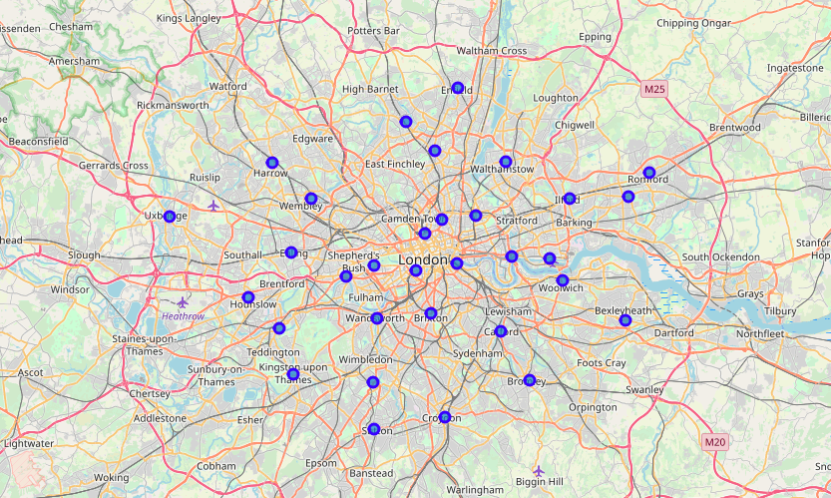
City of London
Divided into 33 Boroughs

Slide 3
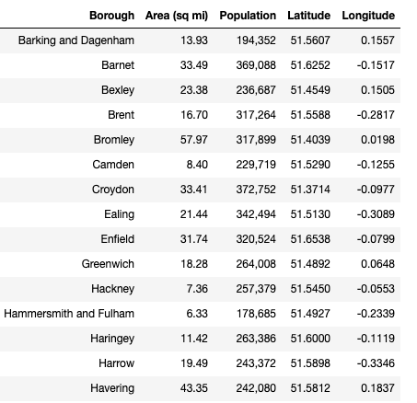
City Data
Available on wikipedia.
Following Features
Borough Name
Area (square miles)
Population
Latitude & Longitude

Slide 4
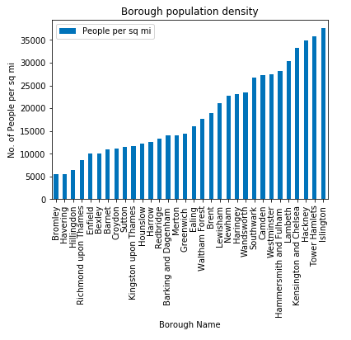
Features detail
Population data (as of 2013)
Lowest population density (by area) is of Bromley
Highest population density is of Islington

Slide 5
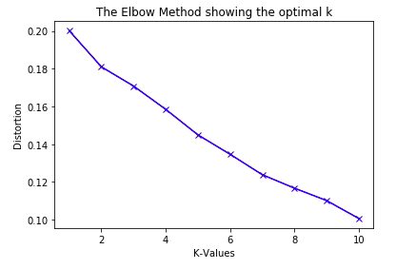
Clusters
To define the best clusters
Generated venues from Foursquare API
Found distortion by k-values for all the different k clusters

Slide 6
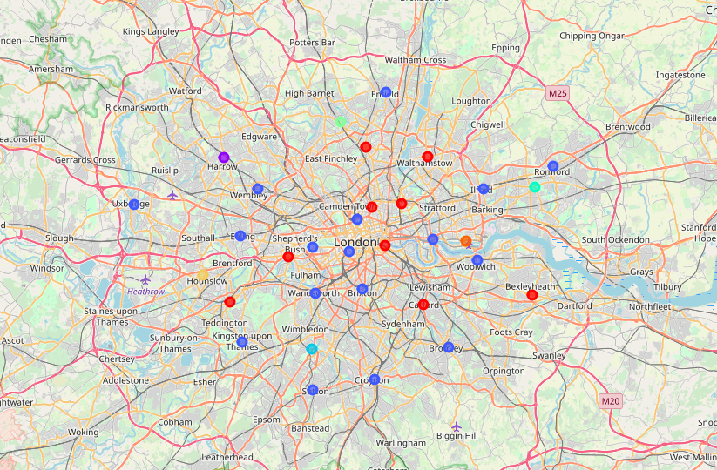
Clustered data
If we choose 8 clusters
City is well divided into these clusters
Each cluster is differentiated by
Venues
Restaurants
Hotels
Recreational areas
So on…

Slide 7
Conclusion
Based on model user can
Find a favourable location to stay
Get the venue details with best ratings
Have a great vacation in London city!!!

Slide 8
Thank You
–Aakash Arora

